Slide 1



HR PRESENSE INSIGHT
View in Power BI
Last data refresh:
10/4/2023 2:02:19 PM UTC
Downloaded at:
10/4/2023 2:10:12 PM UTC

Slide 2
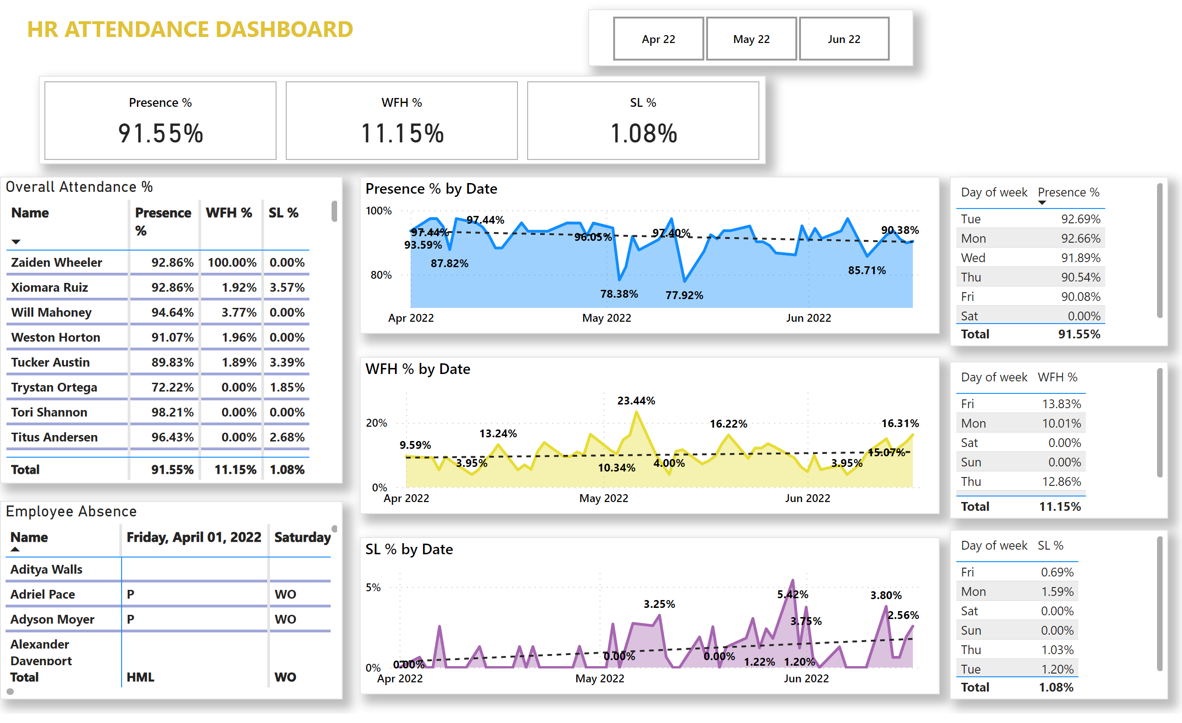
WHITE BACKGROUND
Notes:
Months
No alt text provided
cardVisual
No alt text provided
Overall Attendance %
No alt text provided
textbox
No alt text provided
Employee Absence
No alt text provided
areaChart
No alt text provided
areaChart
No alt text provided
areaChart
No alt text provided
tableEx
No alt text provided
tableEx
No alt text provided
tableEx
No alt text provided

